Slide 1
Cervical Cancer
George Sikivou

Slide 2
What Is It?
The cancer of the cervix, which is caused mainly by the Human Papilloma Virus (HPV)
70% of cervical cancers and precancerous cervical lesions are caused by Types 16, 18.
Most common type is Squamous Cell Carcinoma (SCC)
Notes:
which has at least 100 different types, 13 of which are carcinogenic (High Risk)

Slide 3
Global View

Slide 4
It is the second most common type of cancer faced by women in less developed countries
4th common type of cancer in women worldwide
In 2012, there were 445,000 new cases detected in less developed countries (84%)
270,000 deaths due to Cervical Cancer, 85% were in developing or less developed countries. (WHO Fact Sheet 2014)

Slide 5
Local Statistics:

Slide 6
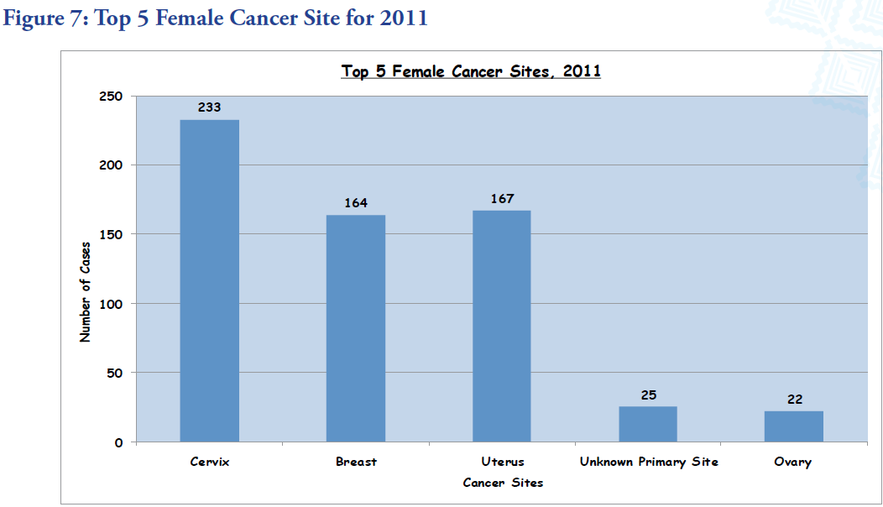
MoH Annual Report - 2011

Slide 7
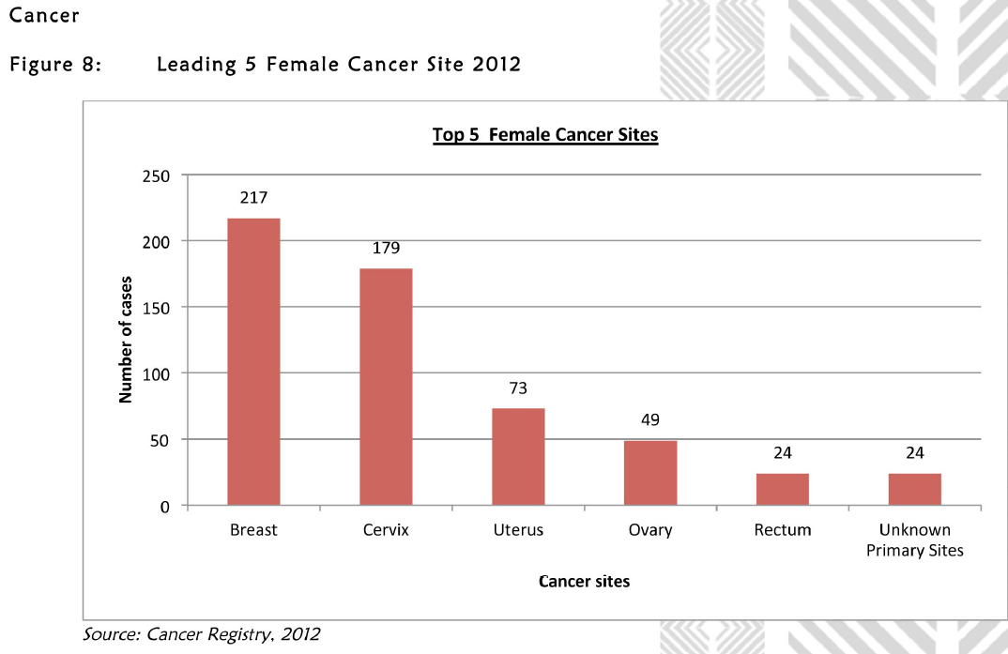
MoH Annual Report 2012

Slide 8
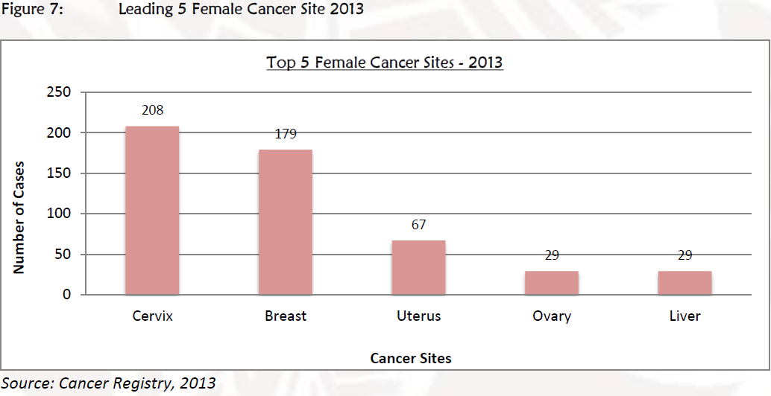
MoH Annual Report 2013

Slide 9
309,334 women are at risk
161 women contract it every year
84 women die from cervical contract
(ICO, 2014)

Slide 10
ICPD
During the ICPD in Cairo (1994) it was declared that Sexual Reproductive Health is a basic human right.
Provision of proper screening and treatment services for cervical cancer is a human right.

Slide 11
Jakarta Declaration
States that one of the pre-requisites for health included “empowerment of women” (Jakarta, 1997)
Increase investments for health development – reflect needs of women

Slide 12
Yanuca Declaration (1995)
“People work and age with dignity”

Slide 13
What Are We Doing?

Slide 14
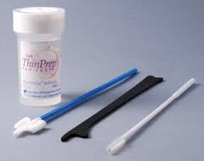
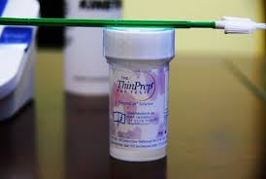
Pap Smears
Recommended for all women who are sexually active/have had sex
Initial pap smear
2nd pap smear: 1 year if normal
Consecutive pap smears every 3 years if normal
Notes:
Named after the Greek Physician/Pathologist; Giorgios Papanikolaou who discovered the pap smears in 1928. To be continued until age of 70

Slide 15
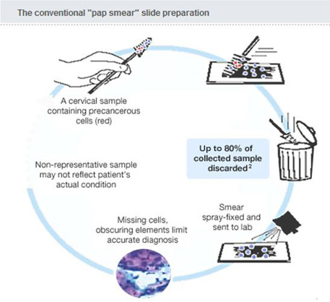
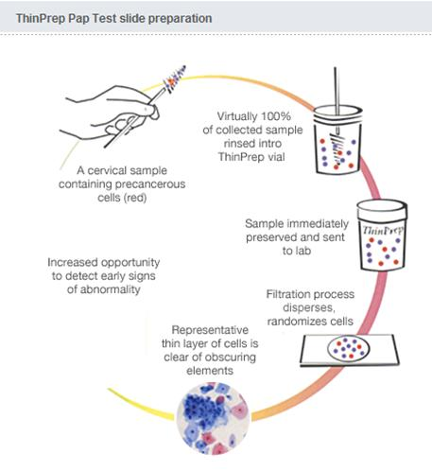
Use of Thin Prep Test in screening.
Sensitivity - 80%, Specificity – 63.2% (Chen et al, 2012)
Sensitivity – 88.3%, Specificity – 87.5% (Zhou et al, 2007)

Slide 16
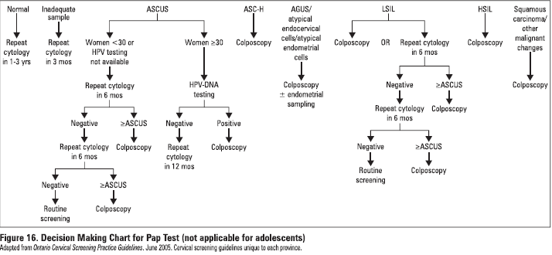

Slide 17
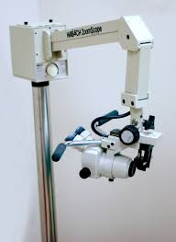
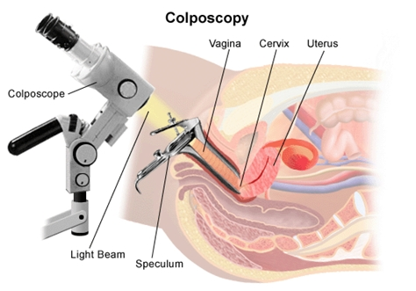
Colposcopy
Abnormal pap smears (HGSIL, SCC) are referred for colposcopy
Results followed up (6 weeks)
64 abnormal pap smears referred, 34 defaulters
Notes:
Defaulted due to lack of contact numbers given, or afraid of results

Slide 18
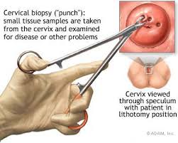
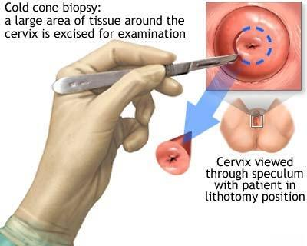

Slide 19
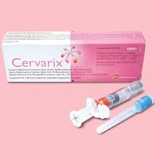
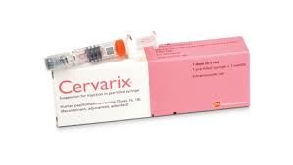
Vaccination
There are 2 main types of vaccines available.
Cervarix is used in Fiji
Protects against Types 16 & 18
Given in 3 doses over 6 months to 13-14 year old girls.
Notes:
The body can also clear the HPV infection in about 24 months. No side effects. May experience symptoms such as fever, pain at the injection site, joint/muscle pain.

Slide 20
Education
During outreach conducted by VSHC, it was shown that:
40.3% of rural women and girls were not aware of the pap smear test
68.31% were not aware/had no knowledge on the frequency of the pap smear test. (VSHC, 2014)

Slide 21
47% of CHW had no knowledge of cervical cancer prior to education, with 6% fair knowledge and 22% had good knowledge
52% of the CHW group having no knowledge and 44% had good knowledge of the risk factors
(VSHC, 2014)

Slide 22
Teachers showed excellent knowledge of cervical cancer (63.46%)
Good knowledge on risk factors (42%)
Good knowledge on prevention (48.15%) (VSHC, 2014)

Slide 23
Challenges:
The 3 delays: - Delay to seek care - Delay to reach proper medical services - Delay in accessing quality health care (lwhp.sogc.org, 2015)

Slide 24
Barriers
Lack of education/awareness
Low education level
Lack of access to medical services
Fear of test/results
Shy
No symptoms
Not at risk (Allen, 2010)
Notes:
Even educated women need more education

Slide 25
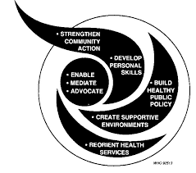
What Can We Do?
Build healthy public policy
Create a supportive environment
Strengthen community action
Develop personal skills
Reorient health services (Ottawa Charter, 1986)

Slide 26
Sundsvaal Statement (1991)
Dimensions : Social – taboos Political – guarantee commitment to human rights Economic – redirecting resources to health/SRH Skills of Women – advocacy and participation in health promotion
Strategies:
Strengthen advocacy – women’s groups
Enable communities/Individuals– education

Slide 27
THANK YOU

Slide 28
References:
Allen, K. (2010). Barriers and Facilitators to Cervical Cancer Screening in Developing Countries, pp. 19-21
Chen, H., Shu, H., Chang, Z., Wang, Z., Yao, H., Zhu, H., Lu, T., Ma, Q. and Yang, B. (2012). Asian Pacific Journal of Cancer Prevention, 13(4), pp.1651-1655.
ICO Information Centeron HPV and Cancer, HPV and related cancers, Fact Sheet 2014.
Iwhp.sogc.org, (2015). The Three Delays - International Women's Health Program. [online] Available at: http://iwhp.sogc.org/index.php?page=the-three-delays&hl=en_US [Accessed 9 Apr. 2015].
Naidu, S., Rajat, G., et al (2014). Empowerment of Rural Women & Girls in Reproductive Health – A VSHC Human Rights Project, pp. 33-58

Slide 29
Ottawa Charter, 1986.
Roberts, J., Gurley, A., Thurloe, J., Bowditch, R. and Laverty, C. (1998). Evaluation of the ThinPrep Pap Test as an Adjunct to the Conventional Pap Smear. Obstetrical & Gynecological Survey, 53(5), pp.280-281.
Sundsvaal Declaration, 1991.
Wu, T. (2008). Cervarix&trade;: a vaccine for the prevention of HPV 16, 18-associated cervical cancer. BTT, p.107.
Zhou, J., Tomashefski Jr., J. and Khiyami, A. (2007). Diagnostic Value of the Thin-Layer, Liquid-Based Pap Test in Endometrial Cancer. Acta Cytologica, 51(5), pp.735-741.

