Slide 1
Sexually Transmitted Infections
By Dexter Chute

Slide 2
Traditional Approaches to Diagnosis
Aetiological Approach
Clinical Approach

Slide 3
Aetiological Appraoch
Pros
Cons
Is the ideal method of diagnosis in a perfect setting
Helps to identify the exact causative organism
Excellent for use in certain circumstances (.eg. Syphillis testing in pregnant women)
Specific treatment does not begin until test results come back (patients may continue spreading the disease during this time and also may not wish to return when results are ready)
Testing facilities are not readily available in all areas
Some organisms are cumbersome to test for given available resources (.eg. H. ducreyi is difficult to culture; Tests for chlamydia is expensive and invasive)

Slide 4
Clinical Approach
Pros
Cons
Excellent approach in areas where lab. Investigations may not be readily available
Some STI’s present with similar symptoms and may lead the clinician to a wrong diagnosis
Depends on clinical experience

Slide 5
Syndromic Case Management
Key features:
Problem oriented (it responds to patients symptoms)
Highly sensitive and does not miss mixed infections
Treats the patient at the first visit
Makes STI care more accessible as it can be implemented at the primary health care level
Uses flowcharts that guide the health worker through logical steps
Provides opportunity and time for education and counselling

Slide 6
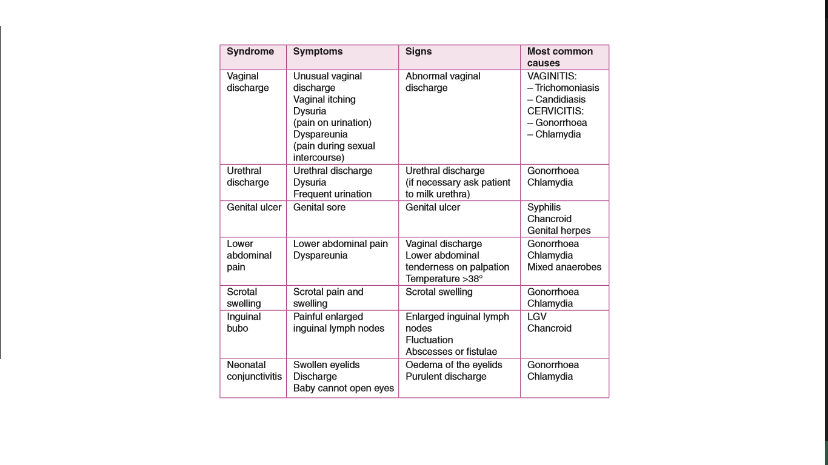

Slide 7
How to Use a Flowchart
Choose the appropriate flowchart that relates to the patients presenting complaint.
Follow the flowchart through and manage accordingly
The flowchart is simple enough to follow but this does not justify clinicians avoiding its use.

Slide 8
History and Physical
Must take into account the individual needs of every patient
CONFIDENTIALITY and PRIVACY are KEY!!!!
Building rapport:
Verbal skills -> how you talk to the patient
Non verbal -> how you behave/react to the patient
Aims:
Make an accurate and efficient syndromic STI diagnosis
Establish a patients risk of transmitting or contracting STI’s
Find out about partners who may have been infected

Slide 9
Treatment
Vaginal Discharge
Vaginitis -> Flagyl
Cervicitis -> AAPA
Urethral Discharge -> AAPA
Genital Ulcer
Syphillis -> Benzathene Penicillin
Chancroid ->
Herpes -> Aciclovir

Slide 10
Lower Abdominal Pain
Gonorrhoea/Chlamydia -> AAPA
Mixed Anaerobes -> Flagyl
Scrotal Swelling -> AAPA
Inguinal Bubo
Chancroid ->
LGV ->
Neonatal Conjunctivitis
Gonorrhoea/Chlamydia -> 1% Tetracycline/Silver Nitrate eye ointment

Slide 11
Education and Counselling
Importance
Knowledge of the disease and its natural process helps improve patient compliance
Preventing re-infection can be obtained through sustained behaviour change
Education
The aim is to make the patient better informed so that she/he can make the patient better informed choice of sexual behaviour and practices
The provision of accurate and truthful information so that the person can become more knowledgeable
Counselling
Relates more to issues of anxiety and coping with the infection or its consequences, biomedically as well as socially
Requires empathy, genuineness and the absence of any moral or personal judgement
Equipped with the right knowledge, the client should seek to change behaviour as a result of counselling

Slide 12
HIV counselling
The patient must be counselled in such a way that helps them deal with the anxiety of having a life long illness
Proper information should be passed on to the patient to prevent any misunderstanding about the disease
How it is spread
Its effect on the patients well being
The outcome of a HIV infection (AIDS)
The difference between HIV and AIDS
The management of HIV/AIDS
Informing all high risk patients on the importance of knowing the HIV Status
Gaining the patients trust in your confidentiality in order to prevent any stigma

Slide 13
Education on Prevention – A few tips!
Changing Sexual Behaviour
Changing from high-risk to low-risk behaviours
Reducing the number of sexual partners/rate of change of sexual partners
Condoms
Common and effective way of preventing STI transmission
Must be able to effectively communicate and educate the patient on correct use of a condom
Demonstration of its use where possible (on a model, obviously!)
Sexual Practice
Informing patients that some sexual practices have a higher risk of STI transmission
Anal sex, whether it is man-to-man or man-to-woman, is a high risk sexual practice
Personal Hygiene and Cultural Practice
Some personal hygiene methods are actually detrimental to health, for example, vaginal douching
An example of good personal hygiene is the direction in which women wipe (front-to-back should be the common practice)
Washing with soap and water may help prevent colonisation with parasites (.eg. Pubic lice/scabies)

Slide 14
Public Health and STI’s

Slide 15
Some Regional Statistics – WHO 2008
WHO estimated that the incidence of selected curable STI’s within the Western Pacific Region was 128.2 million
This figure was calculated from the incidences of 4 selected diseases (40.0 million C. trachomatis; 42.0 million N. gonorrhoea; 0.5 million Syphillis; 45.7 million T. vaginalis)
It was also estimated that at any point in 2008, 37.8 million people had C. trachomatis, 13.3 million people had N. gonorrhoea, 1.2 million people had Syphillis and 30.1 million with T. vaginalis.

Slide 16
Graphical Representation – WHO 2008

Slide 17
Annual Health Report MOH for STI’s
Incidence rates per 100,000 population

Slide 18
Annual Health Report MOH for HIV
Incidence rate per 100,000 population

Slide 19
What do STI’s do to us?
Gonorrhoea and Chlamydia have the tendency to ascend the reproductive tract (.eg. Epididymoorchitis/PID/TOA). This leads to further complications as each disease causes damage
Syphillis is relatively asymptomatic (.ie. Primary – chancre; Secondary – asymptomatic; Tertiary – Neurological)
HIV drops the white cell count causing patients to develop immunocompromisation
Stigma against STI’s lead to patients who are willing to get tested

Slide 20
Because of these complications, other public health issues can arise
MDG 4
Children with HIV are more susceptible to other diseases as well as Failure to Thrive leading to the increase in mortality

Slide 21
MDG 5
If mothers are booked late or are un-booked, the detection of STI’s are significantly reduced during pregnancy
MDG 6
Because of stigma, there may be many undetected cases of HIV which may lead to an increase in spread of HIV

Slide 22
Ottawa Charter
Building a healthy public policy
Policy on Sex Education in schools
Prevention of vertical transmission of HIV
HIV Care and ART Guidelines
HIV Testing and Counselling Policy
Create a supportive environment
Strict confidentiality and privacy
Being supportive and non-judgemental

Slide 23
Strengthening community action
Encouraging the community to take an active role in bringing down sex as a taboo topic
Encouraging those in the community to come forth with any reproductive health issues (all the while ensuring strict confidentiality and privacy)
Develop personal skills
Training health workers and affiliates working in close relation to health workers (.eg. Peer educators, Health educators, etc)
Workshops to improve/update current knowledge of practitioners
Reorient health services
Assess the need for increase in resources to this particular problem (compared to other problems)
Move any available resources over to help alleviate the problem (.eg. Train more personnel to deal/handle the issue at hand, allocate more of the health budget to the issue)

Slide 24
Thanks!

