Slide 1
S.R.P

Slide 2
Key Facts
16 million girls aged 15 – 19yrs and about 1 million girls under 15yrs of age give birth every year
3 million girls aged 15 – 19 undergo unsafe abortions
Prevalent in low and middle income countries
Complications during pregnancy and childbirth are the 2nd cause of death for 15 – 19yr old girls globally
Source: WHO Fact Sheet 2014

Slide 3
Key Facts (cont’d)
Babies born to adolescent mothers have a higher risk of dying
Majority become sexually active before the age of 20 (SIECUS Report)
Situation in Fiji, about 1 in 10 deliveries is to a teenage mother (MOH Report 2011)
Teenage mothers usually being married of early and have their 2nd child within 2 years of the first child (Allen et. Al)

Slide 4
Causes of teenage pregnancy
Lack of education on safe sex and access to information on contraception
Poor socioeconomic status
Peer pressure/risky behavior – experimentation
Substance abuse (alcohol and drugs)
Low self esteem
Sexual abuse

Slide 5
Approach to the Problem
Multidimensional approach:
Individual
Family
Community
Culture/Customs
Breakdown of the risk group:
Teenagers that have not yet fallen pregnant
Teenagers that are young mothers

Slide 6
Issues with Teenage Pregnancy
Medical Problems
Socioeconomic Burden
Psychological Burden

Slide 7
Medical Problems
STI’s e.g. hepatitis and HIV
Anemia
Premature delivery and Low Birth Weight
Increased need for operative or instrument assisted delivery
A teenagers body is simply not ready to accommodate another life

Slide 8
Socioeconomic Burden
Rejection by family and community (Julie A. et al)
Stigmatization by peers
Dropping out of school early
Incomplete or poor quality education resulting in
Lack of employment or a low paying job
Poor income resulting in poor housing, poor maternal feeding & malnourishment of child

Slide 9
Psychological Burden
Guilt
Depression
Anger towards self, father of child and sometimes towards baby
Feeling isolated, helpless and disempowered

Slide 10
Strategies to prevent teenage pregnancy
Programmes to empower girls with knowledge on RH
Making information on contraception more accessible
Address ‘taboos’ regarding the area of sex education and
Getting parents involved in the education of their children
Abstinence-only education without sex education does not work (SIECUS)

Slide 11
Strategies to address teenage pregnancy and help teenage mothers
Empowering teenage mothers with knowledge regarding their reproductive health
Helping them find ways to support themselves and their child through employment opportunities
Enabling them to return to school or to get a higher education after their pregnancy

Slide 12
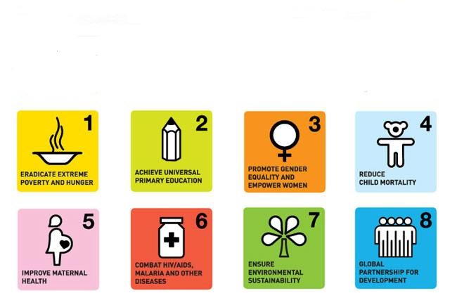
Millennium Development Goals

Slide 13
Young Mothers Project (VSHC)
Healthy Settings (Global Strategy for Health for All by 2000)based approach to Health Promotion (Ottawa Charter strategies)
Creating a supportive environment with the focus being on Healthy Settings ( Sundsvall statement of 1997)
Environments influence on health (rapid pop. Growth)
Sustainable development and people being the driving force

Slide 14
Overview of the VSHC Teen Mums Project
Empower these teenage mothers
Involve their families in their empowerment
Eliminate the stigma
Increase family planning uptake
To be able to replicate this project in other communities
Engage all relevant stakeholders in addressing issues that these young mothers face

Slide 15
Teen Mums Project Outline (VSHC) - 1
Perform a Needs Assessment through the use of a questionnaire
Analyze the findings
Empowerment of young women (strengthen their capacity)
Address RH issues
Changing behavior and attitudes of young mothers

Slide 16
Teen Mums Project Outline (VSHC) - 2
Life skills training
Technical training for employment opportunities
Assist in finding employment or to get higher education

Slide 17
References
Allen, Joseph P. et al. 'Preventing Teen Pregnancy And Academic Failure: Experimental Evaluation Of A Developmentally Based Approach'. Child Development 68.4 (1997): 729-742. Web.
Farber, Naomi. Adolescent Pregnancy. New York: Springer Pub., 2009. Print.
Quinlivan, Julie A. et al. 'Impact Of Demographic Factors, Early Family Relationships And Depressive Symptomatology In Teenage Pregnancy'. Aust NZ J Psychiatry 38.4 (2004): 197-203. Web.
Regional Framework for RH in the WPR.
Sexuality Information & Education Council of the Uniteed States, 2009.

Slide 18
Thank you

